Slide 1
Area Scale Factor
Grade A
08/05/2014
Learning Objectives:
Know what a similar shape is
Able to calculate the linear scale factor
Able to calculate the area of similar
shapes using the area scale factor

Slide 2
Area Scale Factor
How much bigger is rectangle B compared to rectangle A?
2cm
4cm
1cm
2cm
Length → 2cm <-> 4cm
Area → 2cm² <-> 8cm²
The dimensions are two times as big. This is called the Linear Scale Factor.
The area is four times as big. This called the Area Scale Factor.

Slide 3
Area Scale Factor
Linear Scale Factor (LSF) – proportional change in the dimensions of a shape
Area Scale Factor (ASF) – proportional change in the area of a shape
ASF = LSF²

Slide 4
Area Scale Factor
The parallelograms below are similar. The area of the smaller parallelogram is 15cm². Calculate the area of the larger parallelogram.
4cm
12cm

Slide 5
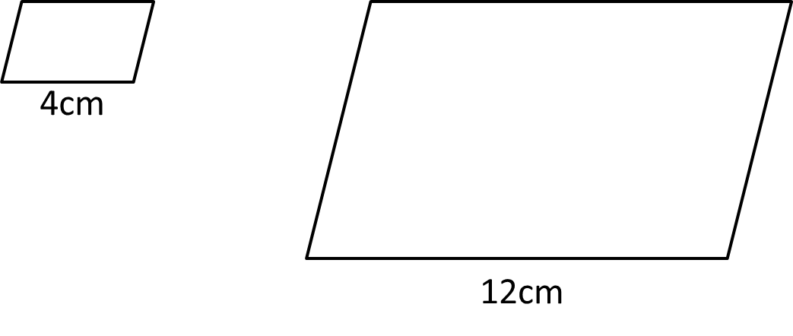
A = 15cm²
Calculate the LSF
LSF = $\frac{Big}{Small}=\frac{12}{4}=3$
2. Calculate the ASF
ASF = $3^{2}=9$
3. Calculate the area of the larger shape
Area = 15 x 9 = 135cm²
(The area of the larger shape is 9 times bigger than the smaller shape)

Slide 6
8cm
12cm
The area of the larger heart shape is 99cm². Calculate the area of the smaller heart shape.
Area = 99cm²
LSF = $\frac{Big}{Small}=\frac{12}{8}=1.5$
ASF = ${1.5}^{2}=2.25$
Area = 99 ÷ 2.25 = 44cm²
(The area of the larger shape is 2.25 times bigger than the smaller shape)

Slide 7
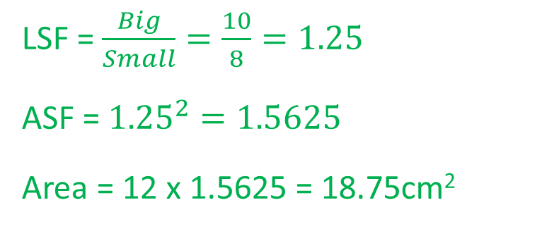
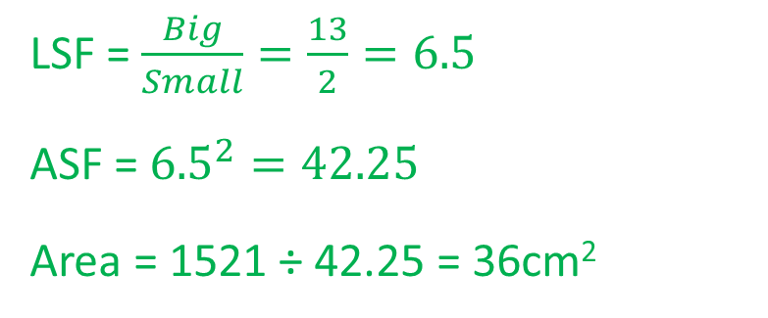
The area of the small crescent is 12cm². Calculate the area of the larger crescent.
8cm
10cm
LSF = $\frac{Big}{Small}=\frac{10}{8}=1.25$
ASF = ${1.25}^{2}=1.5625$
Area = 12 x 1.5625 = 18.75cm²
The area of the large trapezium is 1521cm². Calculate the area of the smaller trapezium.
2cm
LSF = $\frac{Big}{Small}=\frac{13}{2}=6.5$
ASF = ${6.5}^{2}=42.25$
Area = 1521 ÷ 42.25 = 36cm²
13cm

Slide 8
Area Scale Factor
Pages 506 – 507
Exercise 26A
Q1 to 4

Slide 9
4cm
These two regular hexagons are similar. Calculate the length of one of the sides of the larger hexagon.
CV
CV
Area = 12cm²
Area = 300cm²
ASF = $\frac{Big}{Small}=\frac{300}{12}=25$
LSF = $\sqrt{25}=5$
Length = 4 x 5 = 20cm

Slide 10
Area Scale Factor
Page 207
Exercise 26B
Q1 and 2

