Slide 1
Big Picture!
How hard is C1?
http://www.youtube.com/watch?v=qT42DEkKfPI

Slide 2
OBJECTIVE To solve Exam Questions involving conditions on the coefficients for roots of quadratic equations
Recognise this Question type ( features structure etc)
Review assumed prior learning necessary to solve this type of problem
Work through Examples with my help
Video support if required
Worked example in pairs
5 Exam questions
OUTCOME
ALL will be Successful on at least 3 mark questions
Some successful on all questions set
Know it already: work with someone who doesn’t

Slide 3
Exam Questions involving conditions on the coefficeints for roots of quadratic equations

Slide 4
Connect: Roots of Quadratic Equations
What is a quadratic equation?
What are the coefficients of a quadratic equation?
What are the roots of a quadratic equation?
What is the quadratic equation formula?
Which bit is the discriminant?
What is the condition placed upon the discriminant for there to be 2 roots of a quadratic equation?

Slide 5
Quadratic equations
The general form of a quadratic equation in x is:
ax² + bx + c = 0 (where a ≠ 0)
Quadratic equations can be solved by:
factorization
completing the square, or
using the quadratic formula.
The solutions to a quadratic equation are called the roots of the equation.
A quadratic equation may have:
two real distinct roots
one repeated root, or
no real roots.

Slide 6
Using the quadratic formula
Any quadratic equation of the form,
ax² + bx + c = 0
can be solved by substituting the values of a, b and c into the formula,
–b ± √b² – 4ac
x =
2a
This equation can be derived by completing the square on the general form of the quadratic equation.
Notes:
Tell pupils that they are not required to learn this formula since it is given in the examination.
It is a complex formula, however, and so stress that some practice is needed to use it correctly.
Ask pupils if they can see how this formula will lead to two solutions.
More able pupils could be asked to complete the square for the general quadratic equation to derive the formula.

Slide 7
Using b² – 4ac
GCSE
From using the quadratic formula,
–b ± √b² – 4ac
x =
2a
we can see that we can use the expression under the square root sign, b² – 4ac, to decide how many solutions there are.
When b² – 4ac is positive, there are two solutions.
When b² – 4ac is equal to zero, there is one solution.
When b² – 4ac is negative, there are no solutions.

Slide 8
The discriminant
AS
By solving quadratic equations using the formula
we can see that we can use the expression under the square root sign, b² – 4ac, to decide how many roots there are.
When b² – 4ac > 0, there are two real distinct roots.
When b² – 4ac = 0, there is one repeated root:
When b² – 4ac < 0, there are no real roots.
Also, when b² – 4ac is a perfect square, the roots of the equation will be rational and the quadratic will factorize.
b² – 4ac is called the discriminant of ax² + bx + c
Notes:
Explain that when b² – 4ac is greater than 0 and therefore positive √(b² – 4ac) can be evaluated and so the quadratic equation will have two distinct (that is, different) roots.
When b² – 4ac is equal to 0, x = ^{–b}/_{2a}. This is the only root.
When b² – 4ac is less than 0 and therefore negative √(b² – 4ac) has no real value and so the quadratic equation has no real roots.

Slide 9
Quadratic inequalities
An alternative method for solving inequalities involves using graphs. For example:
Solve x² + x – 3 > 4x + 1.
The first step is to rearrange the inequality so that all the terms are on one side and 0 is on the other.
x² – 3x – 4 > 0
Sketching the graph of y = x² – 3x – 4 will help us to solve this inequality.
The coefficient of x² > 0 and so the graph will be ∪-shaped.

Slide 10
Quadratic inequalities
Next, we find the roots by solving x² – 3x – 4 = 0.
Factorizing gives
(x + 1)(x – 4) = 0
x = –1 or x = 4
We can now sketch the graph.
y
y
The inequality
(4, 0)
(–1, 0)
(4, 0)
x² – 3x – 4 > 0
(–1, 0)
0
0
x
x
is true for the parts of the curve that lie above the
x-axis.
So, the solution to x² + x – 3 > 4x + 1 is
x < –1
or
x > 4
Notes:
Explain that when sketching a graph to solve a quadratic inequality we only need to know where the graph crosses the x-axis and whether the graph is ∪-shaped or ∩-shaped. No other points, such as the y-intercept or the vertex, are required.
For quadratic functions that don’t factorize, we can find the roots by completing the square or by using the quadratic equation formula.
Ask students to tell you what the solution would have been if the inequality symbol had been reversed.

Slide 11
Example 1

Slide 12
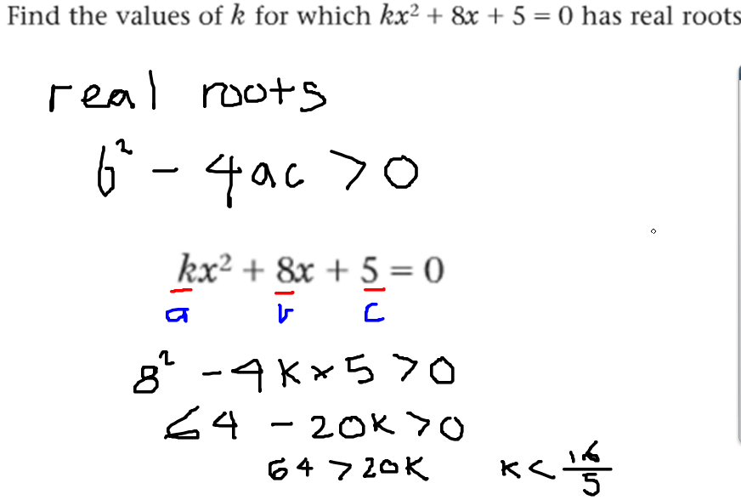

Slide 13
Example 2

