Slide 1
Ratio

Slide 2
Ratio
A ratio compares the sizes of parts or quantities to each other.
For example,
What is the ratio of red counters to blue counters?
red : blue
= 9 : 3
= 3 : 1
For every three red counters there is one blue counter.
Notes:
Talk through the points on the slide showing, with reference to the diagram, that the ratio 9 : 3 is equivalent to the ratio 3 : 1. This is the ratio in its simplest form. Compare this to simplifying fractions.
Ask pupils what statements they can make about the number of red counters compared with the number of blue counters. For example, ‘the number of blue counters is a third of the number of red counters’ or ‘the number of red counters is three times the number of blue counters’.
To distinguish between ratio and proportion you may wish to ask pupils to tell you the proportion of counters that are red (three quarters).
Stress that the ratio compares the sizes of parts to each other while proportion compares the sizes of parts to the whole.

Slide 3
Ratio
A ratio compares the sizes of parts or quantities to each other.
For example,
The ratio of blue counters to red counters is not the same as the ratio of red counters to blue counters.
What is the ratio of blue counters to red counters?
blue : red
= 3 : 9
= 1 : 3
For every blue counter there are three red counters.
Notes:
Note the difference between comparing the number of red counters to the number of blue counters and comparing the number of blue counters to the number of red counters.
You may wish to introduce the idea of a multiplicative inverse by explaining that the inverse of multiplying by a given number is multiplying by its reciprocal. In this example, × 3 is the inverse of × ¹/₃.

Slide 4
Ratio
What is the ratio of red counters to yellow counters to blue counters?
red : yellow : blue
= 12 : 4 : 8
= 3 : 1 : 2
For every three red counters there is one yellow counter and two blue counters.
Notes:
Show that ratios can compare more than two parts or quantities.
Explain with reference to the diagram that 12 : 4 : 8 simplifies to 3 : 1 : 2.

Slide 5
Simplifying ratios
Ratios can be simplified like fractions by dividing each part by the highest common factor.
For example,
21 : 35
÷ 7
÷ 7
= 3 : 5
For a three-part ratio all three parts must be divided by the same number.
For example,
6 : 12 : 9
÷ 3
÷ 3
= 2 : 4 : 3
Notes:
Discuss the simplification of ratios.

Slide 6
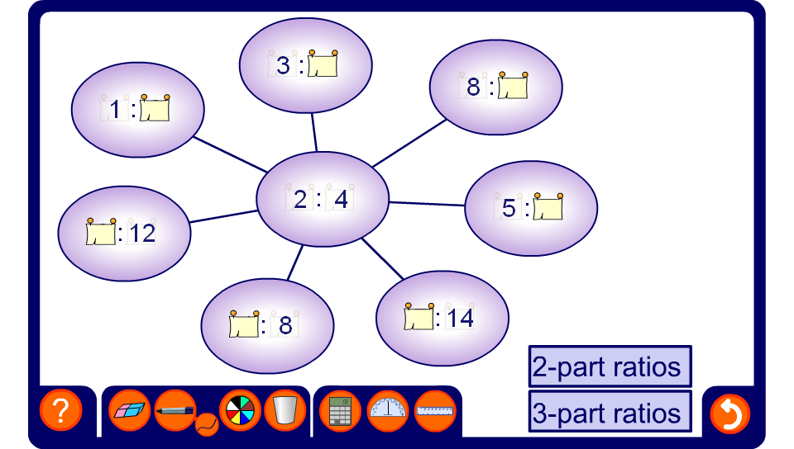
Equivalent ratio spider diagrams
Notes:
This activity revises multiplicative reasoning by asking pupils to scale between a given ratio shown in the centre and other equivalent ratios. There are many ways to find the equivalent ratios using combinations of multiplication and division, or using a singe scale factor. Encourage pupils to discuss their methods as far as possible.
Pupils may also notice that equivalent ratios can be added or subtracted to make other equivalent ratios. For example, adding 6 : 9 to 10 : 15 makes 16 : 24.
This activity can be simplified by first asking pupils to find the ratio in its simplest form and finding this along one of the ‘spider legs’. Every other ratio can then be found by multiplying the parts of the ratio given in its simplest form by a single whole number.

Slide 7
Simplifying ratios with units
When a ratio is expressed in different units, we must write the ratio in the same units before simplifying.
Simplify the ratio 90p : £3
First, write the ratio using the same units.
90p : 300p
When the units are the same we don’t need to write them in the ratio.
90 : 300
÷ 30
÷ 30
= 3 : 10
Notes:
Stress that ratios should always be expressed using the same units for each part.

Slide 8
Simplifying ratios with units
Simplify the ratio 0.6 m : 30 cm : 450 mm
First, write the ratio using the same units.
60 cm : 30 cm : 45 cm
60 : 30 : 45
÷ 15
÷ 15
= 4 :
2 :
3
Notes:
This example shows the simplification of a three part ratio expressed in m, cm and mm.
We could also simplify this ratio be converting the parts to metres (although in this example that would involve working with decimals) or millimetres (although in this example that would involve working with larger numbers).

Slide 9
Simplifying ratios containing decimals
When a ratio is expressed using fractions or decimals we can simplify it by writing it in whole-number form.
Simplify the ratio 0.8 : 2
We can write this ratio in whole-number form by multiplying both parts by 10.
0.8 : 2
× 10
× 10
= 8 : 20
÷ 4
÷ 4
= 2 : 5
Notes:
Tell pupils that we only write ratios with decimals when comparing them in the form 1:m or m:1.
State that multiplying any number that has one number after the decimal point by 10 will give us a whole number. We must then multiply the other part by 10 to preserve equality.
Similarly, if a ratio contains parts with two digits after the decimal point we can multiply the parts by 100 to find an equivalent whole-number ratio.
The whole-number ratio must then be simplified if possible.

Slide 10
Simplifying ratios containing fractions
2
Simplify the ratio : 4
3
We can write this ratio in whole-number form by multiplying both parts by 3.
2
: 4
3
× 3
× 3
= 2 : 12
÷ 2
÷ 2
= 1 : 6
Notes:
Explain that if we multiply a fraction by its denominator then we will always have a whole number. In this example then, we can multiply both parts of the ratio by 3.
The whole-number ratio must then be simplified if possible.

Slide 11
Ratio
ANSWERS
2:3
7:8
2:5
4:5
3:5
7:12
5:8:16
3:7:12
2 and 8
6 and 24
9 and 36
8 and 12
12 and 18
22 and 33
9 and 21
18 and 42
27 and 63
10 and 20 and 30
12 and 24 and 36
50 and 100 and 150
There are 10 girls and 15 boys in a class, what is the ratio of girls to boys in its simplest form?
There are 14 cats and 16 dogs in an animal shelter, what is the ratio of cats to dogs in its simplest form?
There 22 caramels and 55 fudges in a bag of sweets, what is the ratio of caramels to fudges in its simplest form?
Simplify these ratio to their simplest forms:
48:60
45:75
63:108
25:40:80
24:56:96
120:180:600
320:400:440
Archie and Charlie share their Thomas the tank engine toys in the ratio 1:4, how many do they each get if they have:
10 toys b.30 toys c.45 toys
Tom and Jerry share sweets in the ratio 2:3, how many do they each get if they share:
20 sweets b.30 sweets c.55 sweets
Sue and Linda share some money in the ratio 3:7, how many do they each get if they share:
£30 b.£60 c.£90
Mike, Dave and Henry share some little bits of blue tack in the ratio 1:2:3, how many do they each get if they share:
60 pieces b.72 pieces c.300 pieces
Home

