Slide 1
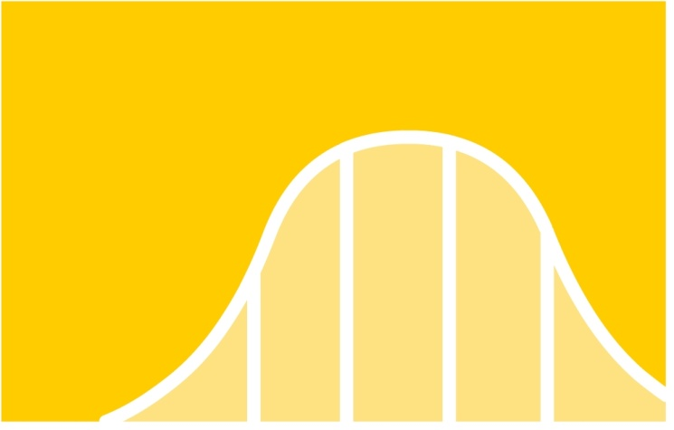
AS-Level Maths: Statistics 1 for Edexcel
S1.1 Representation and summary of data
This icon indicates the slide contains activities created in Flash. These activities are not editable.
For more detailed instructions, see the Getting Started presentation.
1 of 35
© Boardworks Ltd 2005

Slide 2
Graphical representations of data
Simple graphical representations of data: histograms, stem-and-leaf diagrams, quartiles and box plots
Outliers
Cumulative frequency diagrams and linear interpolation
Contents
2 of 35
© Boardworks Ltd 2005

Slide 3
Histograms
A histogram can be used to display grouped continuous data. There are some important points to remember:
The area of each bar in a histogram should be in proportion to the frequency.
When the class widths are not all equal, proportional areas can be achieved by plotting the frequency density on the vertical axis, where
The class width of an interval is calculated as the difference between the smallest and largest values that could occur in that interval.

Slide 4
Histograms
Example: 50 overweight adults tested a new diet. The table shows the amount of weight they lost (in kg) in 6 months.
Notice that the
class widths are not all
equal – frequency
densities need to
be used.
Weight loss (kg) | Frequency
0 – 4 | 12
4 – 6 | 13
6 – 8 | 11
8 – 10 | 7
10 – 15 | 5
15 – 25 | 2
Class width | Frequency density
4 | 3.0
2 | 6.5
2 | 5.5
2 | 3.5
5 | 1
10 | 0.2

Slide 5
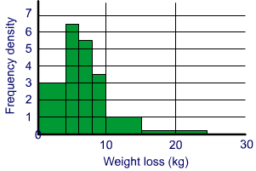
Histograms
Weight loss (kg)
0 – 4
4 – 6
6 – 8
8 – 10
10 – 15
15 – 25
Frequency density
3.0
6.5
5.5
3.5
1
0.2
Histogram to show weight loss
When you draw a histogram, remember to:
plot the frequency densities on the vertical axis;
choose sensible scales for your axes;
label both your axes;
give the histogram a title.

Slide 6
Histograms
Histogram to show weight loss
We can use the histogram to estimate, for example, the number of people who lost at least 12kg:
There were 2 people who lost between 15 and 25 kg.
To estimate how many people lost between 12 and 15 kg, times this new class width by the frequency density for that class: 3 × 1 = 3.
That means that about 5 people lost at least 12 kg.

Slide 7
Histograms
Example: An ornithologist measures the wing spans (to the nearest mm) of 40 adult robins. Her results are shown below.
The measurements
are to the nearest millimetre.
The first interval actually contains
all wing spans between
194.5 and 204.5 mm
Wing span (mm) | Frequency
195 - 204 | 8
205 – 209 | 9
210 – 214 | 11
215 – 224 | 9
225 or over | 3
The measurements
are to the nearest millimetre.
The first interval contains
all wing spans between
194.5 and 204.5 mm
Actual interval | Freq. density
194.5 – 204.5 | 0.8
204.5 – 209.5 | 1.8
209.5 – 214.5 | 2.2
214.5 – 224.5 | 0.9
224.5 – 244.5 | 0.15
The last interval is open-ended. We assume that its width is twice that of the previous interval.

Slide 8
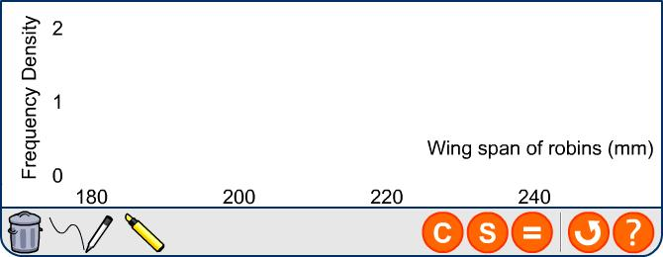
Histograms
Example (continued)
Interval | 194.5 – 204.5 | 204.5 – 209.5 | 209.5 – 214.5 | 214.5 – 224.5 | 224.5 – 244.5
Freq. density | 0.8 | 1.8 | 2.2 | 0.9 | 0.15
A histogram showing the wing spans of robins
Freq. density
Wing span (mm)

Slide 9
Stem-and-leaf diagrams
Stem-and-leaf diagrams are a simple way of showing a set of data graphically. They are formed by splitting each data value into two parts. The first part of the number forms the stem and the second part, the leaf.
Example: A group of 25 people took part in a general knowledge quiz. Their scores are recorded below:
22, 47, 43, 38, 52, 45, 43, 29, 49, 35, 37, 48, 17, 61, 50, 48, 42, 34, 37, 40, 45, 57, 38, 54, 29
Each number naturally splits into 2 parts – the tens digit and the units digit.

Slide 10
Stem-and-leaf diagrams
Stem-and-leaf diagrams are useful as they contain the same degree of accuracy as the original data.

Slide 11
Stem-and-leaf diagrams
It is sometimes necessary to split the contents of each leaf over two rows.
Example: The times (in seconds) taken to run the 400 m by 20 female competitors in the 2004 Olympic Games were: 50.2, 51.5, 50.2, 51.0, 50.5, 51.4, 51.3, 52.2, 50.0, 50.6, 52.0, 51.8, 51.6, 51.2, 51.9, 50.1, 49.9, 52.6, 51.4, 51.6.
These values can be plotted in a stem-and-leaf diagram:
49 | 9 means 49.9 secs
49 | 9
50 | 0 | 1 | 2 | 2
50 | 5 | 6
51 | 0 | 2 | 3 | 4 | 4
51 | 5 | 6 | 6 | 8 | 9
52 | 0 | 2
52 | 6
Stem-and-leaf diagram of times in the 400m
When splitting rows, the top row should contain the digits 0, 1, 2, 3 and 4. Higher digits are put on the second row.

Slide 12
Stem-and-leaf diagrams
Stem-and-leaf diagrams can be used to compare two sets of data. The back-to-back stem-and-leaf diagram shown below compares the height of 15 boys and 12 girls from a form group.
A stem-and-leaf diagram comparing the heights of pupils in a form group
The diagram shows that the boys in the form group are typically taller than the girls. The heights of the boys are also more varied than the girls’ heights.
A more formal comparison of the heights can be made using the median and the inter-quartile range.

Slide 13
Quartiles and box plots
A set of data can be summarised using 5 key statistics:
the median value (denoted Q₂) – this is the middle number once the data has been written in order. If there are n numbers in order, the median lies in position ½ (n + 1).
the lower quartile (Q₁) – this value lies one quarter of the way through the ordered data;
the upper quartile (Q₃) – this lies three quarters of the way through the distribution.
the smallest value,
and the largest value.

Slide 14
Quartiles and box plots
These five numbers can be shown on a simple diagram known as a box-and-whisker plot (or box plot):
Smallest value
Q₁
Q₂
Q₃
Largest value
Note: The box width is the inter-quartile range.
Inter-quartile range = Q₃ – Q₁
The inter-quartile range is a measure of spread.
The semi-inter-quartile range = ½ (Q₃ – Q₁).

Slide 15
Quartiles and box plots
Example: The (ordered) ages of 15 brides marrying at a registry office one month in 1991 were:
18, 20, 20, 22, 23, 23, 25, 26, 29, 30, 32, 34, 38, 44, 53
The median is the ½(15 + 1) = 8th number. So, Q₂ = 26.
The lower quartile is the median of the numbers below Q₂.
So, Q₁ = 22.
The upper quartile is the median of the numbers above Q₂.
So, Q₃ = 34.
The smallest and largest numbers are 18 and 53.

Slide 16
Quartiles and box plots
The (ordered) ages of 12 brides marrying at the registry office in the same month in 2005 were:
21, 24, 25, 25, 27, 28, 31, 34, 37, 43, 47, 61
Q₂ is half-way between the 6th and 7th numbers: Q₂ = 29.5.
Q₁ is the median of the smallest 6 numbers: Q₁ = 25.
Q₃ is the median of the highest 6 numbers: Q₃ = 40.
The smallest and highest numbers are 21 and 61.

Slide 17
Quartiles and box plots
A box plot to compare the ages of brides in 1991 and 2005
It is important that the two box plots are drawn on the same scale.
We can use the box plots to compare the two distributions.
The median values show that the brides in 1991 were generally younger than in 2005. The inter-quartile range was larger in 2005 meaning that that there was greater variation in the ages of brides in 2005.
Note: When asked to compare data, always write your comparisons in the context of the question.

Slide 18
Shapes of distributions
Box plots are useful because they make comparing the location, spread and the shape of distributions easy.
A distribution is roughly symmetrical if Q₂ – Q₁ ≈ Q₃ – Q₂
A distribution is positively skewed if Q₂ – Q₁ < Q₃ – Q₂
A distribution is negatively skewed if Q₂ – Q₁ > Q₃ – Q₂

Slide 19
Examination-style question
Examination-style question: A survey was carried out into the speed of traffic (in mph) on a main road at two times: 8 a.m. and 11 a.m. The speeds of 25 cars were recorded at each time and displayed in a stem-and-leaf diagram:
A stem-and-leaf diagram to show vehicle speed on a main road
a) Find the median and the inter-quartile range for the traffic speeds at both 8 a.m. and 11 a.m.
b) Draw box plots for the two sets of data and compare the speeds of the traffic at the two times.

Slide 20
Examination-style question
As speeds from 25 vehicles were measured, the median would be the 13th value.
8 a.m. 11 a.m.
Q₂ 43 51
Q₁ 34 42
Q₃ 49 60
IQR 15 18
The L.Q. would be the median of the smallest 12 values.
The U.Q. would be the median of the largest 12 values.

Slide 21
Examination-style question
A box plot comparing vehicle speed at 8 a.m. and 11 a.m.
8 a.m. 11 a.m.
Q₂ 43 51
Q₁ 34 42
Q₃ 49 60
IQR 15 18
The box plots show that traffic speed is generally slower at 8 a.m. than at 11 a.m.
The inter-quartile ranges show that there is greater variation in the traffic speed at 11 a.m. than at 8 a.m.
Notice that the speeds at 8 a.m. have a negative skew, whilst the speeds at 11 a.m. are roughly symmetrically distributed.

Slide 22
Outliers
Simple graphical representations of data: histograms, stem-and-leaf diagrams, quartiles and box plots
Outliers
Cumulative frequency diagrams and linear interpolation
Contents
22 of 35
© Boardworks Ltd 2005

Slide 23
Outliers
An item of data that is unusually small or unusually large is classed as an anomaly or an outlier.
An outlier could occur as the result of an error (e.g. a measuring or recording error). The outlier might however be a true value that just happens to be very different from the rest.
A simple rule that is often used is to identify points that are smaller than (Q₁ – 1.5 × IQR) or greater than (Q₃ + 1.5 × IQR) as outliers.
Outliers can be marked on a box plot with an asterisk.
*

Slide 24
Outliers
Example: The annual salaries (in thousands of pounds) of 10 employees of a small company are:
12, 14, 17, 17, 20, 21, 22, 23, 27, 58.
The median salary is half-way between the 5th and 6th values, i.e. Q₂ = 20.5 (or £20,500).
The lower quartile is the median of the lowest 5 values, i.e. Q₁ = 17 (or £17,000).
The upper quartile is the median of the largest 5 values, i.e. Q₃ = 23 (or £23,000).
The IQR is 23 – 17 = 6.

Slide 25
Outliers
Example (continued):
An outlier would be a value less than (Q₁ – 1.5 × IQR) 17 – 1.5 × 6 = 8
or a value more than (Q₃ + 1.5 × IQR) 23 + 1.5 × 6 = 32.
So the value 58 is an outlier.

Slide 26
Cumulative frequency diagrams
Simple graphical representations of data: histograms, stem-and-leaf diagrams, quartiles and box plots
Outliers
Cumulative frequency diagrams and linear interpolation
Contents
26 of 35
© Boardworks Ltd 2005

Slide 27
Cumulative frequency diagrams
A cumulative frequency diagram is useful for finding the median and the quartiles from data given in a grouped frequency table.
There are some important points to remember:
the cumulative frequencies should be plotted above the upper class boundaries of the intervals – don’t use the mid-point.
points can be joined by a straight line (for a cumulative frequency polygon) or by a curve (for a cumulative frequency curve).
A cumulative frequency polygon

Slide 28
Cumulative frequency diagrams
Example: A survey was carried out into the number of hours a group of employees worked.
Hours worked | Frequency
1 – 9 | 3
10 – 19 | 5
20 – 29 | 5
30 – 39 | 35
40 – 49 | 65
50 – 59 | 27
The upper class boundary (u.c.b.) of the first interval is actually 9.5 (as it contains all values from 0.5 up to 9.5).
The table below shows the cumulative frequencies:
u.c.b | 9.5 | 19.5 | 29.5 | 39.5 | 49.5 | 59.5
c.f. | 3 | 8 | 13 | 48 | 113 | 140

Slide 29
Cumulative frequency diagrams
As well as plotting the points given in the previous table, we also plot the point (0.5, 0) – no one worked less than 0.5 hours.
We can estimate the median by drawing a line across at one half of the total frequency, i.e. at 70. We see that Q₂ ≈ 43.
For the lower quartile, a line is drawn at 0.25 × 140 = 35. This gives Q₁ ≈ 36.
Drawing a line at 0.75 × 140 = 105, we see that Q₃ ≈ 48.
You don’t need to add 1 before halving the frequency when the data is cumulative
So the inter-quartile range is 48 – 36 = 12.

Slide 30
Cumulative frequency diagrams
Examination-style question: The cumulative frequency diagram shows the marks achieved by 220 students in a maths examination.
a) Estimate the median and the 95th percentile.
b) Where should the pass mark of the examination be set if the college wishes 70% of candidates to pass?

Slide 31
Cumulative frequency diagrams
a) The median will be approximately the 220 ÷ 2 = 110th value. This is about 61%.
The 95th percentile lies 95% of the way through the data. A line is drawn across at 0.95 × 220 = 209. This gives a mark of 84%.

Slide 32
Cumulative frequency diagrams
The college wants 70% of 220 = 154 students to pass. Therefore 66 students will get a mark below the pass mark.
Drawing a line across at 66 gives a pass mark of about 55%.

Slide 33
Linear interpolation
It is possible to estimate the median, the quartiles and any percentile from a grouped frequency table without drawing a cumulative frequency diagram.
Example: A farmer records the mass of a sample of 500 apples:
Mass (g) | 120 - 139 | 140 - 159 | 160 - 169 | 170 - 189 | 190 - 239
Frequency | 64 | 109 | 177 | 97 | 53
Estimate the median mass of his apples, and the value of the upper quartile.

Slide 34
Linear interpolation
The data in this example has been rounded to the nearest gram. The actual class boundaries of each interval are:
Mass (g) | 119.5 – 139.5 | 139.5 – 159.5 | 159.5 – 169.5 | 169.5 – 189.5 | 189.5 – 239.5
Frequency | 64 | 109 | 177 | 97 | 53
The median will be approximately the weight of the ½n = 250th apple. This lies in the interval 159.5 – 169.5.
173 values up to 159.5
159.5
169.5
177 values in the interval
Median ≈ (to 3 s.f.)
l.c.b
class width

Slide 35
Linear interpolation
Mass (g) | 119.5 – 139.5 | 139.5 – 159.5 | 159.5 – 169.5 | 169.5 – 189.5 | 189.5 – 239.5
Frequency | 64 | 109 | 177 | 97 | 53
The upper quartile will be approximately the weight of the 0.75n = 375th apple. This lies in the interval 169.5 – 189.5.
350 values up to 169.5
169.5
189.5
97 values in the interval
Upper quartile ≈ (to 3 s.f.)

