Slide 1
Rules of Logs

Slide 2
Solving equations using logs
You can solve equations involving powers of $x$ by ‘taking logs’.
Example 1: $2^{x}=60$
Example 2: $5^{x−3}=12$
Example 3: $6^{2x}−2\left(6^{x}\right)−15=0$
Solving equations involving logs
Example: $\log_{5}\left(x+1\right)=\log_{5}{x}+3$

Slide 3
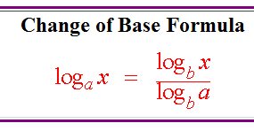
Example: Find $\log_{2}{7}$.
$$\log_{2}{7}=\frac{\log_{10}{7}}{\log_{10}{2}}$$
This can be evaluated on a calculator using the log button.
Challenge:

Slide 4
What does the graph of $\log{x}$ look like?
x | 0.00001 | 0.0001 | 0.001 | 0.01 | 0.1 | 0 | 1 | 10
Log x
An extra row showing x as a power of 10 may be useful!
How is this graph linked to the graph of $y={10}^{x}$?

