Slide 1
Starter

Slide 2
Volume Scale Factor
Grade A
08/05/2014
Learning Objectives:
Able to calculate a Linear Scale Factor
Able to calculate a Volume using the LSF
Able to calculate areas using the VSF

Slide 3
Volume Scale Factor
Volume Scale Factor (VSF): The proportional increase in the volume of two similar shapes
VSF = LSF³

Slide 4
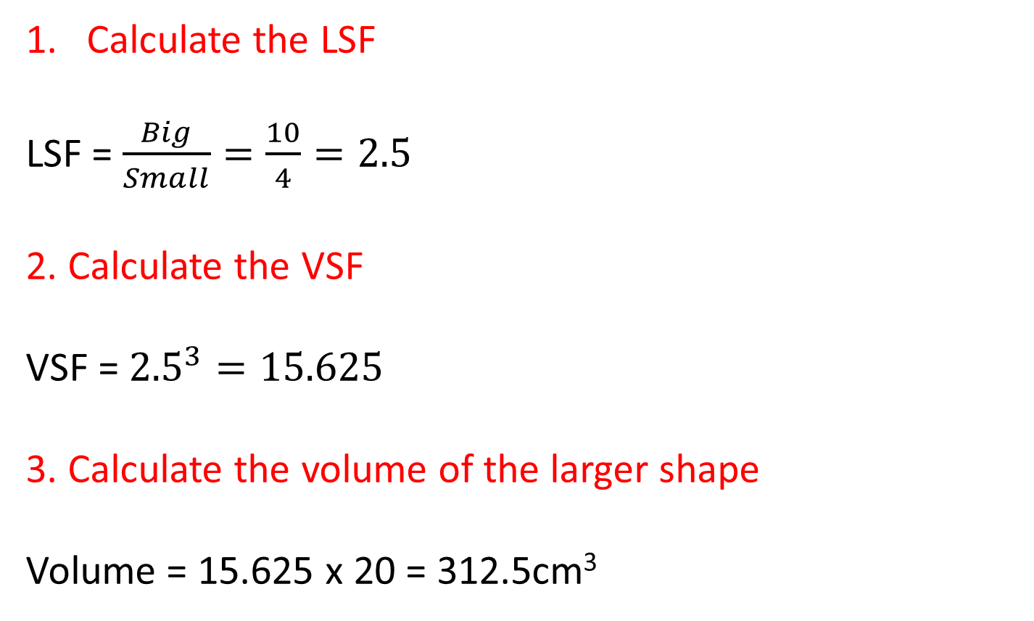
10cm
The volume of the smaller cylinder is 20cm³. Calculate the volume of the larger cylinder.
4cm
Calculate the LSF
LSF = $\frac{Big}{Small}=\frac{10}{4}=2.5$
2. Calculate the VSF
VSF = ${2.5}^{3}=15.625$
3. Calculate the volume of the larger shape
Volume = 15.625 x 20 = 312.5cm³
(The volume of the larger shape is 15.625 times bigger than the smaller shape)

Slide 5
LSF = $\frac{Big}{Small}=\frac{30}{24}=1.25$
VSF = ${1.25}^{3}=1.953125$
Volume = 1.2 ÷ 1.953125 = 0.61 litres (2sf)
(The volume of the larger shape is 1.953125 times bigger than the smaller shape)

Slide 6
Volume Scale Factor
Grade A
08/05/2014
Page 509
Exercise 26C
Questions 1 to 4
Page 509-510
Exercise 26D
Questions 1 – 5

Slide 7
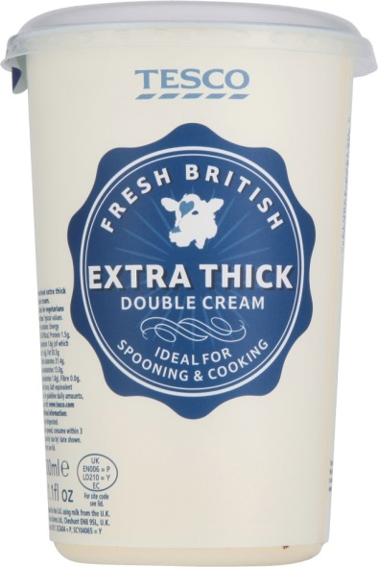
The smaller carton of double cream holds 125ml, while the larger carton holds 200ml. Calculate the height of the larger carton.
11cm
VSF = $\frac{Big}{Small}=\frac{200}{125}=1.6$
LSF = $\sqrt[3]{1.6}=1.1696…$
Height = 1.1696… x 11 = 12.87cm (2dp)

Slide 8
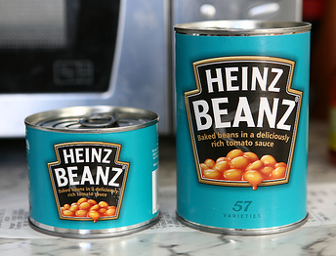

The larger tin of beans has a mass of 400g while the smaller tin has a mass of 50g. The label on the smaller tin has an area of 150cm². Calculate the area of the label on the larger tin.
VSF = $\frac{Big}{Small}=\frac{400}{50}=8$
LSF = $\sqrt[3]{8}=2$
ASF = $2^{2}=4$
Area of label = 4 x 150 = 600cm²

Slide 9
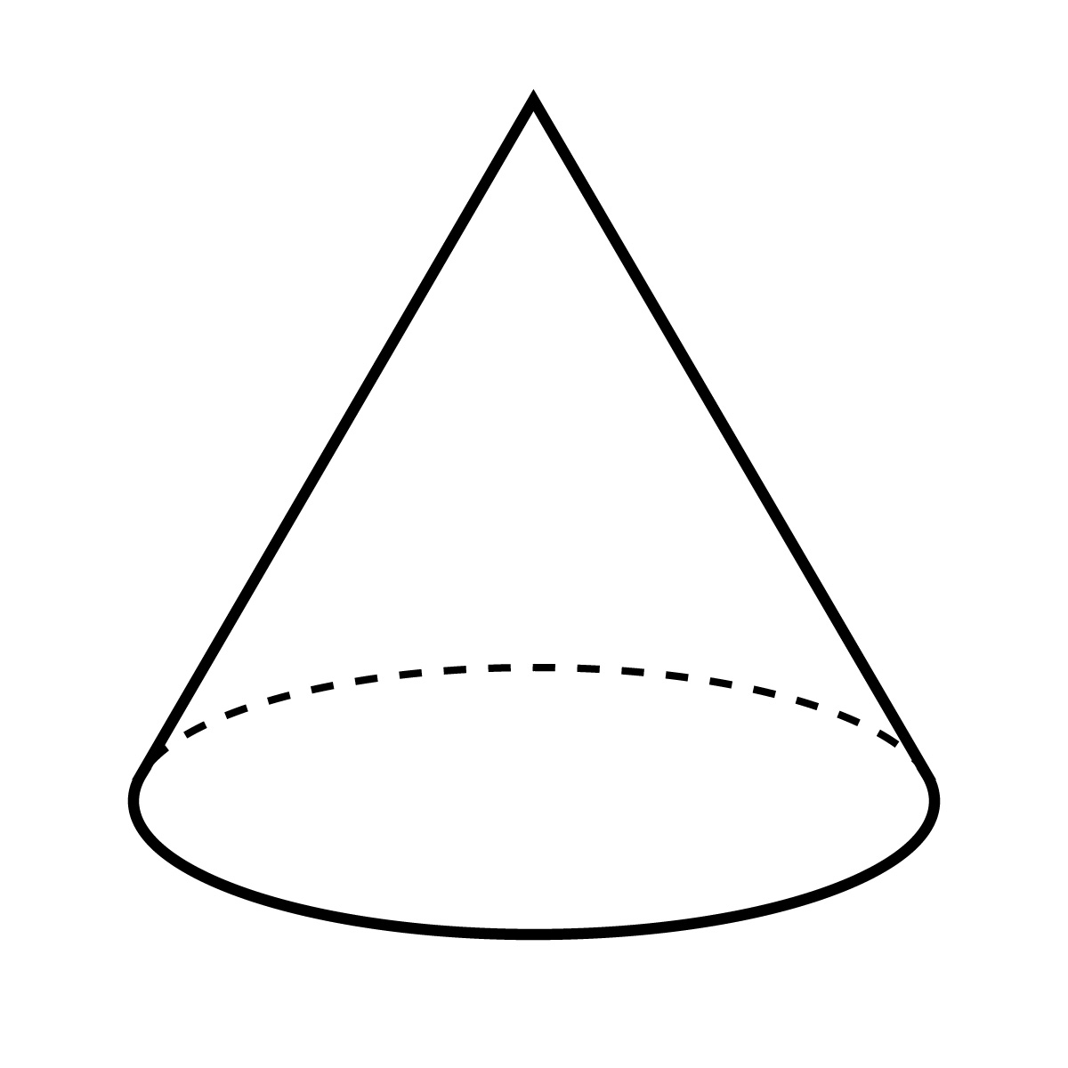
The surface area of cone B is 12.25 times bigger than cone A. If the volume of cone B is 380cm³, calculate the volume of cone A. Give your answer correct to 3 significant figures.
A
B

Slide 10
Similar Shapes
Page 511
Exercise 26E
Q1 to 6

